Slide 1
RETAIL
PROJECT
Presented By : Riya Kushwaha

Slide 2
Index
Business Context
Problem Statement
Data Availability
Data Inconsistency
Data Cleaning
Exploratory data analysis
Customer Behavior
Cross – Selling Product
Category Behavior
Customer Satisfaction
Cohort Analysis
Sales, Trend and Pattern
Recommendation
Image source: icons8`

Slide 3
Business Context
To provide data-driven insights and strategies to the client, a well - known retail chain in India, in order to improve CRM, marketing, campaigns, and sales performance through the utilization of historical point-of-sales data. The main objectives are as follows:
Understanding Customer Behavior
Product and Category Analysis
Enhancing Store and Channel Effectiveness
Sales Trend and Forecasting
Improving Customer Satisfaction
Key Business Insights and Recommendations
Image source: icons8`

Slide 4
Problem statement
Are there any missing, duplicate, or inconsistent records, outliers in the data?
What are the sales, profit, and quantity trends across different time frames (e.g., months, quarters, years)?
Which regions, stores, and channels contribute the most to sales and profit?
Which channels and payment methods are preferred by customers?
Which products are the most and least popular overall and within specific stores/regions?
What is the total sales and profit contribution of each category?
Which categories and products have the highest and lowest average ratings?
Are there patterns in average ratings by store, product category, or geography?
What are the sales trends by day, week, month, and quarter?
Etc…
Image source: icons8`

Slide 5
DATA AVAILABILITY
Image source: icons8`

Slide 6
Tables
Order Table
Customer
Table
OrdersPayment
Table
StoresInfo
Table
OrderReview
Table
ProductsInfo
Table
Image source: icons8`

Slide 7
Data availability
1. Customers Table :
(i) CustId (ii) Customer_City (iii) Customer_State (iv) Gender
2. Orders Table :
(i) Customer_Id (ii) Order_Id (iii) Product_Id (iv) Channel
(v) Delivered_StoreID (vi) Bill_date_timestamp (vii) Quantity (viii) Cost Per Unit
(ix) MRP (x) Discount (xi) Total Amount
3. OrderPayments Table :
(i) Order_id (ii) Payment_type (iii) Payment_value
4. OrderReview_Ratings Table :
(i) Order_id (ii) Customer_Satisfaction_Score
5. ProductsInfo Table :
(i) Product_id (ii) Category (iii) Product_name_length
(iv) Product_Description_Length (v) Product_photo_qty (vi) Product_weight_g
(vii) Product_length_cm (viii) Product_height_cm (ix) Product_width_cm
6. StoresInfo Table :
(i) Store_Id (ii) Seller_City (iii) Seller_State (iv) Region
Image source: icons8`

Slide 8
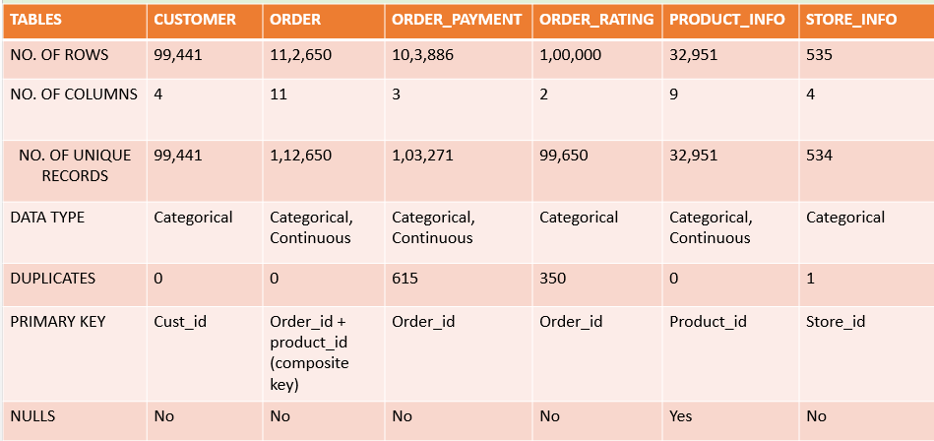
Data availability
Image source: icons8`

Slide 9
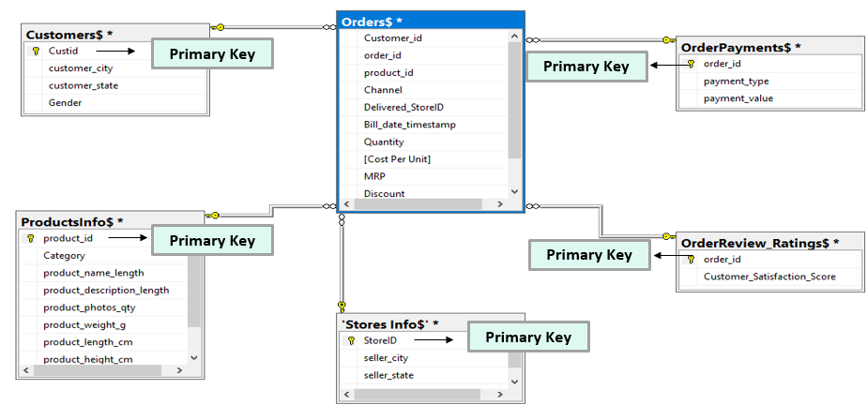
ER diagram
Image source: icons8`

Slide 10
ER diagram
Relationship b/w the table :
Table1 | Table2 | Relationship
Order | Customer | Many to One
Order | Order payment | Many to Many
Order | Order review ratings | Many to One
Order | Product Info | Many to One
Order | Stores Info | Many to One
Foreign Keys :
- In Orders table, CustomerId for Customer table
- ProductId for ProductsInfo table
- Delivery StoreId for StoresInfo
- Order Id for Order Payment & OrderReview_Rating table
Image source: icons8`

Slide 11
DATA INCONSISTENCIES
Image source: icons8`

Slide 12
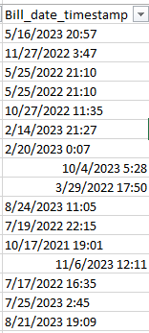
Data inconsistency
The dates in Orders table are not in proper format.
2. In Orders table, there are records in which the customer_id, order_id, product_id is same but different
quantity with same date
3. There are some records, same order has different Store ID at same time
Image source: icons8`

Slide 13

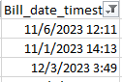
Data inconsistency
4. The Customer_id, Order_id is same but different Product_id with cumulative quantity at same time.
5. Its given that, data is available from Sep 2021 to Oct 2023 but in Orders table 2020 data is also available.
6. Also, having the records after Oct 2023 as(Nov, Dec)
Image source: icons8`

Slide 14

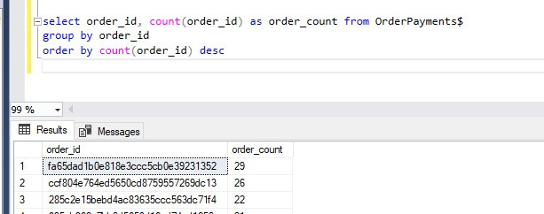
Data inconsistency
7. In Orders table, One Order_id assigned to multiple Customers.
8. Some Order_id having Payment_value 0 with Payment_type is UPI/Cash.
9. In OrderPayments table, One Orders ID have multiple payments
Image source: icons8`

Slide 15
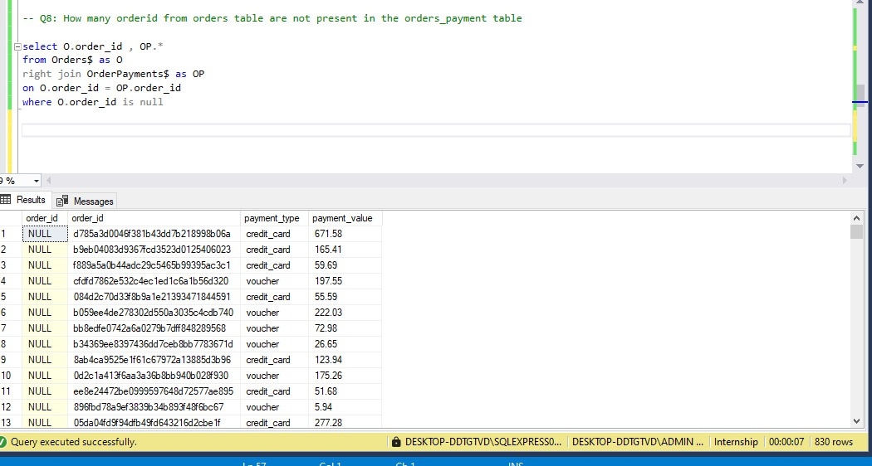
Data inconsistency
10. 830 OrderId from Orders table are not in the OrderPayments table
Image source: icons8`

Slide 16
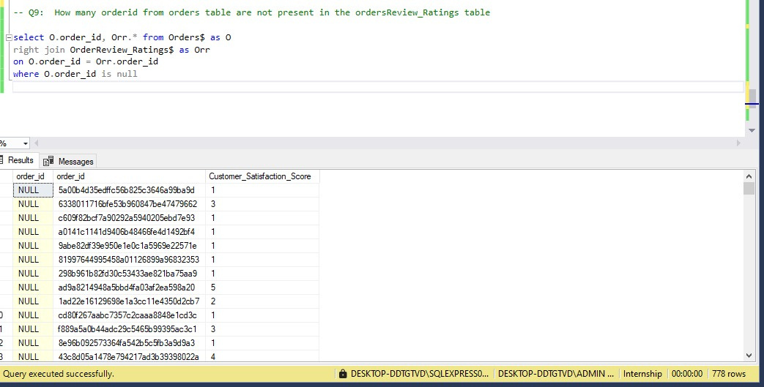
Data inconsistency
11. 778 OrderId from the orders table are not in OrdersReview_Rating Table
Image source: icons8`

Slide 17
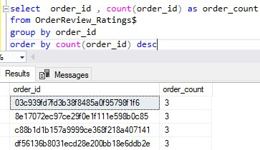
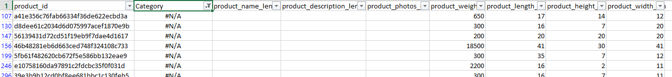
Data inconsistency
12. In OrderReview_Ratings table, One OrderId has been given multiple reviews
13. In ProductInfo table, there are #N/A and some Nulls
14. In ProductInfo table, Weight column having weight 0
Image source: icons8`

Slide 18
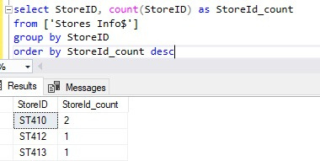
Data inconsistency
15. In StoresInfo, One Store ID has provided its address twice , (e.g. - ST410)
Image source: icons8`

Slide 19
DATA CLEANING
Image source: icons8`

Slide 20
Flow chart
Orders Table
11,2,650
88,631
24,016
13,793
6,553
8,029
7,725
304
Final Records
1,02,464
Image source: icons8`

Slide 21
Data Cleaning
11,2,650 : Total Records in Orders table.
24,016 : Total records of the mismatched order_ids after aggregating the total amount from the Orders table and the Payment_value from the OrderPayments table.
88,631 : Total matched records.
13,793 : Total records of the result after resolving inconsistencies where customer_id, order_id, and product_id are the same, but the cumulative quantity differs.
8,029 : Total records of the mismatched order_ids after re-aggregating the total amount from the Orders table and the Payment_value from the OrderPayments table.
6553 : Total matched records.
7,725 : Matched records after recalculating the total amount column in the Orders table and then
re-aggregating them.
304 : Mismatched Records.
1,02,909 : Adding 88,631 + 6553 + 7,725
1,02,467 : Replace the values of Quantity column with 1 in the Orders Table (with 2020 data)
1,02,464 : After removing 2020 data.
Image source: icons8`

Slide 22
Final Data
Orders_360
102,464
Total records
Customers_360
98,311
Total records
Stores_360
37
Total records
Image source: icons8`

Slide 23
EXPLORATORY DATA ANALYSIS
Image source: icons8`

Slide 24
Exploratory data analysis - i
CUSTOMER LEVEL
ORDER LEVEL
Total Customers : 98,311
Total Customer City : 4,109
Average Profit per Customer : 23.83
Average Discount per Customer : 4.98
Average Sales per Customer : 160.50
Average number of category per Customer : 1.04
Average number of Days b/w two Transactions : 5
Total Orders : 98,402
Total Quantity : 1,11,897
Total Channels : 3
Total Payment method : 4
Average Discount per Order : 4.98
Average item per Order : 1.04
Average Order Value : 160.35
Image source: icons8`

Slide 25
Exploratory data analysis - i
PRODUCT LEVEL
STORE LEVEL
Total Category : 14
Total Product : 32,887
Total Stores : 37
Total Region : 4
Total Seller City : 37
Total State : 7
SALES LEVEL INFORMATION
Total Revenue : 15.78 M
Total Profit : 23.43 L
Total Cost : 12.74 M
Average Sales per Customer : 160.50
Profit Percentage : 17.56 %
Image source: icons8`

Slide 26
Exploratory data analysis - ii
Image source: icons8`

Slide 27
Exploratory data analysis - ii
Image source: icons8`

Slide 28
Exploratory data analysis - ii
Image source: icons8`

Slide 29
Exploratory data analysis - ii
Image source: icons8`

Slide 30
Exploratory data analysis - ii
Image source: icons8`

Slide 31
Exploratory data analysis - ii
Image source: icons8`

Slide 32
Exploratory data analysis - ii
Image source: icons8`

Slide 33
Exploratory data analysis - ii
Image source: icons8`

Slide 34
Exploratory data analysis - ii
Image source: icons8`

Slide 35
Exploratory data analysis - ii
Image source: icons8`

Slide 36
Exploratory data analysis - ii
Image source: icons8`

Slide 37
Exploratory data analysis - ii
Image source: icons8`

Slide 38
Exploratory data analysis - ii
Observations :
In 2023, the company consistently gained more new customers compared to 2021 and 2022, peaking in March, May, August, and November, while revenue from existing customers, which began modestly in 2022, continued to grow.
In 2023, the retention rate was highest, peaking in August and December. In 2022, March had the highest retention rate, while there was zero retention in 2021.
In 2023, revenue from existing customers steadily increased, peaking in July, while revenue from new customers, after strong performance in 2022, showed slight declines in late 2023.
The southern region leads in both quantity and sales, with credit cards being the most frequently used payment method.
Andhra Pradesh has the highest customer count, while store ST103 records the maximum number of orders.
Toys & Gifts is the category most ordered by customers, followed by Baby, which also has a high purchase rate.
Andhra Pradesh has the highest purchases in Toys & Gifts, Home Appliances, Food & Beverages, Furniture, and Luggage Accessories.
Toys & Gifts and Home appliances contribute to the highest sales amount.
There are 32,887 products that appeared in the transaction.
ST103 is the best-performing store, while ST133 is the worst.
Image source: icons8`

Slide 39
CUSTOMER BEHAVIOR
Image source: icons8`

Slide 40
Customer Behavior
Low : Amount <= 500
Medium : B/w 500 and 1000
High : > 1000
Image source: icons8`

Slide 41
Customer Behavior
RFM Segmentation : RFM segmentation is a analysis method that involves analyzing customer behavior based on three key factors: recency, frequency, and monetary value.
Recency (R) : When was the last time they purchased?
Frequency (F) : How often and for how long have they purchased?
Monetary Value/Sales (M) : How much have they purchased
Now divide the Recency, Frequency and Monetary by using NTILE FUNCTION, which divide the customers into 4 groups such as Standard, Silver, Gold, Platinum Customers
R_score : A score for recency, where the most buyers get higher scores.
F_score : A score for frequency, where customers who have made more purchases get higher scores.
M_score : A score for Monetary, where customers who have spent more money get higher scores.
RFM_Score : Combination of R, F, and M scores
Image source: icons8`

Slide 42
Customer Behavior
Standard customers: RFM scores between 3 and 6
Silver customers: RFM scores between 7 and 8
Gold customers: RFM scores between 9 and 10
Premium customers: RFM scores between 11 and 12
Image source: icons8`

Slide 43
Customer Behavior
RFM Segmentation
Observation :
The majority of customers fall under the ‘Standard category’ (10.36 K).
Using RFM segmentation analysis, we observe that Platinum and Gold customers are fewer in number compared to Standard and Silver customers.
The minority of customers fall under the ‘Platinum Category’ (3.24).
Recommendation :
Analyze the behavior of Silver customers and identify strategies to encourage higher spending or more frequent purchases to convert them into Gold customers.
Collect feedback from Platinum customers to understand their needs and improve their experience.
Develop targeted campaigns to encourage Standard customers to move into higher segments (e.g., Gold or Platinum) by offering exclusive benefits, loyalty programs, or discounts on larger purchases.
Image source: icons8`

Slide 44
Customer Behavior
Buyer Type | Total Customers | Total Quantity | Total Revenue | Average Spend
One-Time Buyer | 98275 | 116654 | 16482768.8 | 167.720873
Repeat Buyer | 36 | 152 | 16914.99 | 469.860833
Image source: icons8`

Slide 45
Customer Behavior
One – Time buyers v/s Repeat buyers
Observation :
One-time buyers contribute more than repeat buyers in terms of both revenue and quantity.
Recommendation :
Send personalized follow-up emails after a purchase, asking for feedback, offering product recommendations, or providing discounts on future purchases to encourage return visits.
Launch a loyalty program where customers earn points for every purchase, redeemable for discounts or rewards, motivating them to make repeat purchases to unlock more benefits.
Image source: icons8`

Slide 46
Customer Behavior
1. The number of customers that purchased in all the channels and their key metrics.
2. Behavior of customers that purchased one category and purchased multiple categories
3. Behavior of discount seekers & non discount seekers
Image source: icons8`

Slide 47
Customer Behavior
Multiple – Category v/s Single – Category Purchasers
Observation :
The majority of customers are Single-Category purchasers, with a customer count of 97,569, compared to Multi-Category purchasers (742).
Single-Category purchasers contribute the most to revenue generation.
Recommendation :
Offer time-sensitive promotions, such as "Buy 1 from Category A, Get 1 from Category B at 50% off
Introduce a rewards program where customers earn points or discounts for purchasing across multiple categories.
Create attractive product bundles that encourage customers to purchase items from different categories at a discounted rate.
Highlight the benefits of buying across multiple categories.
Introduce a rewards program where customers earn points or discounts for purchasing across multiple categories.
Image source: icons8`

Slide 48
Customer Behavior
Discount seekers v/s Non – Discount seekers
Observation :
Discount seekers are fewer than non-discount seekers.
The majority of customers are Non – Discount seekers, with a customer count of 65,757, compared to Discount seekers 40,186
Recommendation :
Offer special discounts exclusively for new or existing customers who haven’t yet shown interest in discounts.
Provide additional benefits for customers who actively seek discounts, such as offering them access to exclusive loyalty programs where they receive points or discounts on future purchases.
This can turn occasional discount-seekers into regular shoppers.
Image source: icons8`

Slide 49
Customer Behavior
Image source: icons8`

Slide 50
Customer Behavior
Observation :
The maximum number of customers belong to the low revenue category (≤ $500).
One-time buyers contribute more than repeat buyers in terms of both revenue and quantity.
There is only one customer who has purchased from all the channels.
The number of multiple-category purchasers is less than that of single-category purchasers.
Discount seekers are fewer than non-discount seekers.
The preferred channel for customers is 'Instore.‘
The preferred payment type among customers is 'Credit Card.‘
The preferred store among customers is 'ST103.‘
The preferred category among customers is 'Toys & Gifts.'
Image source: icons8`

Slide 51
CROSS SELLING OF PRODUCTS
Image source: icons8`

Slide 52
Cross selling of products - 1
Image source: icons8`

Slide 53
Cross selling of products - 2
Combination of 3 Buying Products together
PRODUCT_1 | PRODUCT_2 | PRODUCT_3 | Triplet Count
Toys & Gifts | Stationery | Construction_Tools | 2
Home_Appliances | Computers & Accessories | Construction_Tools | 2
Baby | No data | Luggage_Accessories | 1
Toys & Gifts | Furniture | Home_Appliances | 1
Electronics | Fashion | Auto | 1
Pet_Shop | Luggage_Accessories | Furniture | 1
Home_Appliances | Furniture | Baby | 1
No data | Baby | Luggage_Accessories | 1
Construction_Tools | Pet_Shop | No data | 1
Baby | Toys & Gifts | Luggage_Accessories | 1
Construction_Tools | Auto | Baby | 1
Home_Appliances | Construction_Tools | Baby | 1
Food & Beverages | Computers & Accessories | Luggage_Accessories | 1
Image source: icons8`

Slide 54
Cross selling of products - 1
Observations :
Combination of 2 buying categories together
- Home Appliances and Baby are the most frequently cross-sold products, with an order count of 77.
- Furniture and Baby are also commonly bought with order count of 70.
Combination of 2 buying categories together
Toys & Gifts, Stationery, and Construction Tools are the combination of products most frequently purchased.
- Home Appliances, Computers & Accessories, and Construction Tools are also commonly bought together.
Recommendation :
Offer targeted discounts or bundles for less common pairings to encourage customers to try new combinations.
Use customer purchase data to suggest personalized cross-selling combinations at checkout (e.g., "Customers who bought Furniture also purchased Fashion items").
Highlight complementary products that are less commonly paired but align with customer interests.
Provide rewards for customers who purchase across multiple categories in a single transaction (e.g., loyalty points or discounts for buying from 3+ categories).
Image source: icons8`

Slide 55
CATEGORY BEHAVIOR
Image source: icons8`

Slide 56
Category Behavior
Category | SALES_AMT | Cumulative Sales | Cumulative Percentage of Sales
Toys & Gifts | 2.64 M | 2.64 M | 16.70
Home Appliances | 1.79 M | 4.42 M | 28.01
Baby | 1.71 M | 6.13 M | 38.86
Food & Beverages | 1.65 M | 7.78 M | 49.30
Luggage_Accessories | 1.64 M | 9.42 M | 59.70
Furniture | 1.35 M | 10.77 M | 68.26
Computers & Accessories | 1.29 M | 12.06 M | 76.41
Construction_Tools | 1.10 M | 13.16 M | 83.39
Auto | 0.68 M | 13.84 M | 87.73
Stationery | 0.68 M | 14.52 M | 92.03
Electronics | 0.55 M | 15.07 M | 95.51
Pet_Shop | 0.25 M | 15.32 M | 97.11
Fashion | 0.24 M | 15.57 M | 98.65
No data | 0.21 M | 15.78 M | 100.00
Pareto analysis is a decision-making tool used to compare and fix problems strategically. It uses the Pareto principle, which is also known as the 80/20 rule
Image source: icons8`

Slide 57
Category Behavior
Image source: icons8`

Slide 58
Category Behavior
Image source: icons8`

Slide 59
Category Behavior
Category Penetration
The aim of calculating “Category Penetration” is to know, how popular that category is
Category Penetration = Number of Orders containing that category * (100)
Total number of Order
Image source: icons8`

Slide 60
Category Behavior
Image source: icons8`

Slide 61
Category Behavior
Image source: icons8`

Slide 62
Category Behavior
Image source: icons8`

Slide 63
Category Behavior
Category Penetration
Observations :
In October 2021, Toys & Gifts had the highest penetration.
In the year 2022:
- Toys & Gifts had the highest penetration throughout the year, except in February, when Furniture has the highest penetration.
- Pet Shop had the least penetration.
In the year 2023:
- From Jan to August, Toys & Gifts had the highest penetration and # NA has the least.
- In September, the Toys & Gifts and Food & Beverages categories had the highest penetration and Pet shop has the least.
Image source: icons8`

Slide 64
Category Behavior
Category Penetration
Recommendation :
Launch seasonal campaigns during peak months to further boost its performance.
Analyze the reasons for low penetration (e.g., limited product range, awareness, or demand).
Highlight the category in advertising campaigns and optimize inventory to capitalize on customer interest.
Investigate why #NA consistently has the least penetration and address potential data or categorization issues.
During periods where Food & Beverages and Toys & Gifts both have high penetration, design cross-category promotions (e.g., family-friendly deals) to drive sales across multiple categories.
Use customer segmentation to recommend complementary products based on purchase behavior.
Image source: icons8`

Slide 65
Category Behavior
Image source: icons8`

Slide 66
Category Behavior
Observations :
This supports the Pareto principle: a small number of categories contribute to the majority of sales.
Toys & Gifts has the highest individual sales amount and contributes 16.7% to total sales.
The top five categories collectively account for almost 60% of total sales.
The bottom categories (Auto, Stationery, Electronics, Pet Shop, Fashion, and No Data) together contribute approximately 12% of total sales.
The "Home Appliances" category has the highest profit percentage (13.35%).
Recommendation :
Identify specific issues (e.g., pricing, product quality, inventory, or marketing) for low-performing categories like Auto, Stationery, Electronics, Pet Shop, and Fashion.
Introduce targeted promotions or bundle deals to boost sales in these categories.
Analyze the strategies contributing to the high profit percentage in Home Appliances and apply them to other categories to increase margins.
Conduct promotional events or flash sales for underperforming categories to attract customer attention.
Image source: icons8`

Slide 67
CUSTOMER SATISFACTION
Image source: icons8`

Slide 68
Customer Satisfaction
Image source: icons8`

Slide 69
Customer Satisfaction
Image source: icons8`

Slide 70
Customer Satisfaction
Observations :
Pet Shop and Food & Beverages have the highest ratings.
#NA(Unknown) and Furniture have the lowest ratings.
By store, ST138 has the highest rating.
By state, West Bengal has the highest rating.
By seller city, Ponnur has the highest rating.
By month, August has the highest rating.
By category, Pet Shop contributes the highest rating.
Recommendation :
Highlight customer reviews and ratings to build trust and encourage purchases.
Investigate the reasons for low ratings in these categories, such as product quality, pricing, or delivery issues.
Analyze the factors contributing to high ratings in August, such as product mix, promotions, or customer service quality, and replicate these strategies in other months.
Develop strategies to elevate other underperforming categories, ensuring consistent customer experience across all offerings.
Image source: icons8`

Slide 71
COHORT ANALYSIS
Image source: icons8`

Slide 72
Cohort Analysis (Fixed Month)
Cohort Analysis : Cohort analysis is a form of behavioral analytics that sorts customer data into smaller groups based on similar traits, and then analyzes the behavior of the groups to uncover patterns.
Those patterns can inform strategic decision-making and product development.
In fixed month retention cohort analysis, how many customers from a cohort month made purchases in other months.
We Compare the repeating customers and cohort customers by comparing their purchases and revenue. Then we calculate the retention rate .
Retention Rate : In month on month retention analysis, we need to compare customers who made transactions in one month to those who made transaction in the next month (consecutive).
Image source: icons8`

Slide 73
Cohort Analysis (Fixed Month)
Table Column Description
Column Name | Description
Cohort Year | First purchase year of the customer
Cohort Month | First purchase month of the customer
Cohort Customers | Customers who made their first purchase in a particular month
Repeat Customers | Customers who made purchase in months other than cohort month
Retention Rate | Number of Repeat customers * 100 / Number of Cohort customers
Average Month to Repeat Customers | Some of month taken by each repeat customers to make subsequent purchases/ Number of Cohort customers
Total Revenue – Cohort customers | Total revenue from Cohort customers
Total Order – Cohort customers | Number of Orders from Cohort customers
Total Revenue – Repeat customers | Total revenue from repeat customers
Total Order – Repeat customers | Number of Orders from Cohort customers
Image source: icons8`

Slide 74
Cohort Analysis (Fixed Month)
Cohort Years | Cohort Months | Cohort Customers | Repeat Customers | Retention Rate | Average Month to Repeat Customers | Total Revenue Cohort customers | Total Order Cohort customer | Total Revenue Repeat customer | Total Order Repeat customer
2021 | 8 | 8 | 0 | 0 | 0 | 1102.38 | 9 | 0 | 0
2021 | 9 | 9 | 0 | 0 | 0 | 1864 | 13 | 0 | 0
2021 | 10 | 222 | 0 | 0 | 0 | 39420.94 | 252 | 0 | 0
2021 | 11 | 42 | 0 | 0 | 0 | 8152.17 | 49 | 0 | 0
2021 | 12 | 25 | 0 | 0 | 0 | 5784.16 | 32 | 0 | 0
2022 | 1 | 1665 | 2 | 0.12 | 2 | 260565.14 | 1963 | 182.53 | 2
2022 | 2 | 1708 | 1 | 0.059 | 15 | 279920.15 | 1922 | 18.56 | 1
2022 | 3 | 3064 | 2 | 0.065 | 7 | 505682.98 | 3510 | 348.62 | 2
2022 | 4 | 2662 | 1 | 0.038 | 6 | 441186.45 | 3014 | 110.84 | 1
2022 | 5 | 3732 | 3 | 0.08 | 2 | 594905.99 | 4223 | 473.63 | 5
2022 | 6 | 3401 | 2 | 0.059 | 5 | 573437.91 | 3838 | 317.3 | 2
2022 | 7 | 4006 | 2 | 0.05 | 2 | 605891.59 | 4533 | 238.13 | 2
2022 | 8 | 4174 | 3 | 0.072 | 6 | 654381.21 | 4787 | 258.14 | 3
2022 | 9 | 4103 | 0 | 0 | 0 | 658318.89 | 4620 | 0 | 0
2022 | 10 | 4129 | 2 | 0.048 | 5 | 672136.57 | 4727 | 509.41 | 3
2022 | 11 | 6195 | 4 | 0.065 | 4 | 993311.42 | 7112 | 629.13 | 4
2022 | 12 | 4601 | 2 | 0.043 | 2 | 733612.04 | 5178 | 286.03 | 2
Image source: icons8`

Slide 75
Cohort Analysis (Fixed Month)
Cohort Years | Cohort Month | Cohort Customers | Repeat Customers | Retention Rate | Average Month to Repeat Customers | Total Revenue Cohort customers | Total Order Cohort customers | Total Revenue Repeat customers | Total Order Repeat Customers
2023 | 1 | 5973 | 0 | 0 | 0 | 908753.25 | 6743 | 0 | 0
2023 | 2 | 5630 | 2 | 0.036 | 5 | 845900.78 | 6425 | 194.66 | 3
2023 | 3 | 6048 | 2 | 0.033 | 3 | 960769.89 | 6915 | 297.76 | 2
2023 | 4 | 5223 | 3 | 0.057 | 5 | 873518.19 | 5977 | 360.74 | 5
2023 | 5 | 6104 | 0 | 0 | 0 | 1011140.79 | 7040 | 0 | 0
2023 | 6 | 5934 | 2 | 0.034 | 2 | 975302.32 | 6786 | 423.29 | 4
2023 | 7 | 5431 | 3 | 0.055 | 1 | 890001.68 | 6126 | 476.06 | 3
2023 | 8 | 6619 | 0 | 0 | 0 | 1036664.81 | 7444 | 0 | 0
2023 | 9 | 2117 | 0 | 0 | 0 | 345245.52 | 2411 | 0 | 0
2023 | 10 | 1761 | 0 | 0 | 0 | 296752.67 | 2000 | 0 | 0
2023 | 11 | 1839 | 0 | 0 | 0 | 314500.23 | 2110 | 0 | 0
2023 | 12 | 1886 | 0 | 0 | 0 | 290812.49 | 2138 | 0 | 0
Image source: icons8`

Slide 76
Cohort Analysis (Fixed Month)
Observations :
There are 30 cohorts in total.
In Aug 2023 cohort has maximum number of customers(6619).
In Aug, Sep 2021 has the lowest number of customers 8 , 9 respectively.
Jan 2022 has the highest retention rate(0.12%).
Feb 2022 has the highest average month for repeat customers (15).
May and Aug 2023 has the highest revenue by cohort customers.
Highest revenue by repeat customers in Nov 2022 (629.13)
There are 13 cohorts with no repeat customers.
Maximum order by cohort customer in Aug 2023 (7444).
Maximum order by repeat customer in May 2022 and Apr 2023 (5)
Image source: icons8`

Slide 77
Cohort Analysis (Month by Month Retention)
In Month – by – Month retention cohort analysis, we analyze how many customers from cohort month made purchases in each of the next 12 months.
This analysis help us to compare the different groups of customer.
In this analysis, we take the cohort month as Month_0 in the table
Customers who made purchases after 1 month is in the Month_1.
We perform the same method for all the months, from Month_1 to Month_12.
Image source: icons8`

Slide 78
Cohort Analysis (Month by Month Retention)
Table Column Description
Column Name | Description
Cohort Month | First purchase month of the customer
Month_0 | Cohort Customers
Month_1 | Customers in month_0 who made purchases after 1 month
Month_12 | Customers in month_0 who made purchases after 12 month
Image source: icons8`

Slide 79
Cohort Analysis (Month by Month Retention)
Cohort Month | Retention by Month
 | Month_0 | Month_1 | Month_2 | Month_3 | Month_4 | Month_5 | Month_6 | Month_7 | Month_8 | Month_9 | Month_10 | Month_11 | Month_12
2021 – 08 | 8 | 0 | 0 | 0 | 0 | 0 | 0 | 0 | 0 | 0 | 0 | 0 | 0
2021 – 09 | 9 | 0 | 0 | 0 | 0 | 0 | 0 | 0 | 0 | 0 | 0 | 0 | 0
2021 – 10 | 222 | 0 | 0 | 0 | 0 | 0 | 0 | 0 | 0 | 0 | 0 | 0 | 0
2021 – 11 | 42 | 0 | 0 | 0 | 0 | 0 | 0 | 0 | 0 | 0 | 0 | 0 | 0
2021 – 12 | 25 | 0 | 0 | 0 | 0 | 0 | 0 | 0 | 0 | 0 | 0 | 0 | 0
2022 – 01 | 1665 | 0 | 0 | 0 | 0 | 1 | 0 | 2 | 1 | 0 | 1 | 0 | 0
2022 – 02 | 1707 | 0 | 0 | 0 | 0 | 0 | 0 | 0 | 0 | 0 | 0 | 0 | 0
2022 – 03 | 3064 | 1 | 0 | 0 | 0 | 0 | 0 | 0 | 0 | 0 | 0 | 0 | 0
2022 – 04 | 2662 | 0 | 0 | 0 | 0 | 0 | 1 | 0 | 0 | 0 | 0 | 0 | 0
2022 – 05 | 3732 | 0 | 1 | 1 | 0 | 0 | 0 | 0 | 0 | 0 | 0 | 0 | 0
2022 – 06 | 3401 | 0 | 0 | 0 | 0 | 0 | 0 | 0 | 0 | 0 | 0 | 0 | 0
2022 – 07 | 4006 | 0 | 1 | 0 | 0 | 0 | 0 | 0 | 0 | 0 | 0 | 0 | 0
2022 – 08 | 4175 | 0 | 0 | 0 | 1 | 0 | 0 | 0 | 0 | 0 | 0 | 0 | 0
2022 – 09 | 4103 | 0 | 0 | 0 | 0 | 0 | 0 | 0 | 0 | 0 | 0 | 0 | 0
2022 – 10 | 4129 | 1 | 1 | 0 | 0 | 0 | 0 | 0 | 0 | 0 | 0 | 0 | 0
Image source: icons8`

Slide 80
Cohort Analysis (Month by Month Retention)
Cohort Month | Retention by Month
 | Month_0 | Month_1 | Month_2 | Month_3 | Month_4 | Month_5 | Month_6 | Month_7 | Month_8 | Month_9 | Month_10 | Month_11 | Month_12
2022 – 11 | 6195 | 0 | 0 | 0 | 0 | 0 | 0 | 0 | 0 | 0 | 0 | 0 | 0
2022 – 12 | 4601 | 0 | 0 | 0 | 0 | 0 | 0 | 0 | 0 | 0 | 0 | 0 | 0
2023 – 01 | 5962 | 0 | 0 | 0 | 0 | 0 | 0 | 0 | 0 | 0 | 0 | 0 | 0
2023 – 02 | 5625 | 0 | 0 | 0 | 0 | 1 | 1 | 0 | 0 | 0 | 0 | 0 | 0
2023 – 03 | 6039 | 0 | 0 | 0 | 2 | 0 | 0 | 0 | 0 | 0 | 0 | 0 | 0
2023 – 04 | 5223 | 0 | 0 | 0 | 1 | 0 | 2 | 0 | 0 | 0 | 0 | 0 | 0
2023 – 05 | 6100 | 0 | 0 | 0 | 0 | 0 | 0 | 0 | 0 | 0 | 0 | 0 | 0
2023 – 06 | 5930 | 0 | 0 | 0 | 1 | 0 | 0 | 0 | 0 | 0 | 0 | 0 | 0
2023 – 07 | 5437 | 2 | 0 | 1 | 0 | 0 | 0 | 0 | 0 | 0 | 0 | 0 | 0
2023 – 08 | 6621 | 0 | 0 | 0 | 0 | 0 | 0 | 0 | 0 | 0 | 0 | 0 | 0
2023 – 09 | 2123 | 0 | 0 | 0 | 0 | 0 | 0 | 0 | 0 | 0 | 0 | 0 | 0
2023 – 10 | 1762 | 0 | 0 | 0 | 0 | 0 | 0 | 0 | 0 | 0 | 0 | 0 | 0
2023 – 11 | 1848 | 0 | 0 | 0 | 0 | 0 | 0 | 0 | 0 | 0 | 0 | 0 | 0
2023 – 12 | 1895 | 0 | 0 | 0 | 0 | 0 | 0 | 0 | 0 | 0 | 0 | 0 | 0
Image source: icons8`

Slide 81
Cohort Analysis (Month by Month Retention)
Observation :
The cohort month of January 2022 has the highest number of customers who made repeat purchases.
5 customers from this cohort made repeat purchases in the next 10 months
Customers from 17 cohorts didn’t make any purchases in the next 12 months
Customers from 3 cohorts, made purchases in the immediate month after cohort month:
▪ Mar 2022
▪ Oct 2022
▪ Jul 2023
Cohort January 2022 had the longest delay for repeat purchases (5 months)
Last 5 cohorts did not have any repeat customers in the following 12 months.
Image source: icons8`

Slide 82
SALES TRENDS
Image source: icons8`

Slide 83
Sales trends, Patterns & Seasonality
Image source: icons8`

Slide 84
Sales trends, Patterns & Seasonality
Image source: icons8`

Slide 85
Sales trends, Patterns & Seasonality
Image source: icons8`

Slide 86
Sales trends, Patterns & Seasonality
Image source: icons8`

Slide 87
Sales trends, Patterns & Seasonality
Observations :
In August, sales are at their peak.
In September, sales are at their lowest.
By week, in terms of average sales, Friday has the highest average sales, while Sunday has the lowest.
In terms of total sales, Wednesday has the highest total sales, while Friday has the lowest.
By quarter, Quarter 2 contributes the most to sales, while Quarter 1 contributes the least.
Weekdays have higher sales compared to weekends
Recommendation :
Introduce targeted promotions, seasonal campaigns, and discounts to mitigate the sales dip in September.
Gather customers feedback to understand their needs and preferences.
Create exclusive Friday deals to maintain the peak average sales and launch special Sunday campaigns to improve its performance.
Focus on New Year promotions or early-year campaigns to increase sales.
Image source: icons8`

Slide 88
RECOMMENDATION
Image source: icons8`

Slide 89
Recommendation for Weak Points
Low Customer Retention:
Personalized Service: Use customer data to offer personalized recommendations and services.
Improve Support: Ensure prompt and effective customer service through multiple channels (chat, email, phone).
Customer Feedback: Actively seek and act on feedback to show customers their input matters.
Personalize Marketing and Promotions
Targeted Campaigns: Send personalized emails or messages with offers tailored to specific customer segments.
Dynamic Recommendations: Use AI to suggest products based on customer browsing and purchase history.
Sales
Promotion Effectiveness: Analyze which promotions drive the most sales and replicate successful strategies.
Analyse previous data: Leverage historical sales data to identify recurring patterns and predict future trends, enabling better planning and resource allocation.
Utilize Targeted Advertising: Deploy reminders or targeted advertisements during peak sales times to increase platform traffic. For example, during summer break or the 2nd last quarter of the year.
Image source: icons8`

Slide 90
Recommendation for Weak Points
Other Recommendations :
Offer time-sensitive promotions, such as "Buy 1 from Category A, Get 1 from Category B at 50% off ”
Investigate the reasons for low ratings in these categories, such as product quality, pricing, or delivery issues.
Introduce targeted promotions, seasonal campaigns, and discounts
Use customer segmentation to recommend complementary products based on purchase behavior.
Provide rewards for customers who purchase across multiple categories in a single transaction (e.g., loyalty points or discounts for buying from 3+ categories).
Provide additional benefits for customers who actively seek discounts, such as offering them access to exclusive loyalty programs where they receive points or discounts on future purchases.
Based on customer preferences and strong-performing product categories (like for combination of Baby and home appliances products), consider introducing complementary items to enhance the offering.
Promote the use of In-store and phone delivery channels, as these are favored by customers. Highlight the convenience and advantages of these channels in marketing.
Image source: icons8`

Slide 91
Thank you!
Image source: icons8`

